Slide 1


Encapsulation, Inheritance, Polymorphism

Slide 2

Data members
Methods

Slide 3
Object Orientation
PHP is an Object-Oriented programming language
Fundamental feature of OO is the class
PHP classes support
  Encapsulation
  Inheritance
  Polymorphism

Slide 4


Slide 5
What is a Class?
Classes
  Sophisticated ‘variable types’
  Data variables (data members) and functions (methods) are wrapped up in a class. Collectively, data members and methods are referred to as class members.
An instance of a class is known as an object.
//defining a new class named Robot
class Robot {
//place class members here...
}

Slide 6


Slide 7
Instantiating a class using new
Once a class has been created, any number of object instances of that class can be created.
$dogRobot = new Robot();
To invoke methods:
  object->method()
e.g.
<?php
....
$dogRobot = new Robot();
$dogRobot ->crawlWeb();
$dogRobot -> play();
echo $dogRobot ->talk();
...
?>

Slide 8
Defining classes
<?php
class Person {
private $strFirstname = “Napoleon";
private $strSurname = “Reyes";
function getFirstname() {
return $this->strFirstname;
}
function getSurname() {
return $this->strSurname;
}
}
// outside the class definition
$obj = new Person; // an object of type Person
echo "<p>Firstname: " . $obj->getFirstname() . "</p>";
echo "<p>Surname: " . $obj->getSurname() . "</p>";
?>
Data members
Methods
Example16-.php

Slide 9
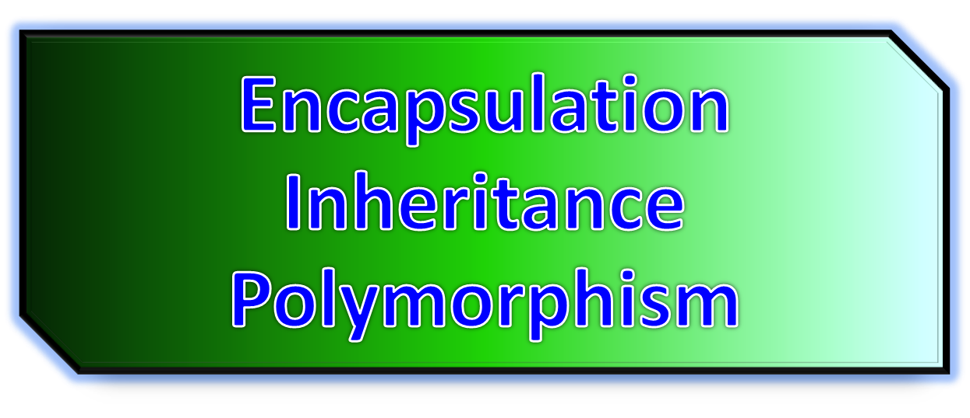

Slide 10
Encapsulation
Data members are normally set inaccessible from outside the class (as well as certain types of methods) protecting them from the rest of the script and other classes.
This protection of class members is known as encapsulation.
e.g.
<?php
....
$dogRobot = new Robot();
$dogRobot ->crawlWeb();
$dogRobot -> play();
echo $dogRobot ->talk();
...
?>

Slide 11
Inheritance
New classes can be defined very similar to existing ones. All we need to do is specify the differences between the new class and the existing one.
Data members and methods which are not defined as being private to a class are automatically accessible by the new class.
This is known as inheritance and is an extremely powerful and useful programming tool.

Slide 12
Polymorphism
A concept where a number of related classes all have a method, which shares the same name.
class Fish { draw()... //draws a fish... }
class Dog { draw()... //draws a dog... }
class Bird { draw()... //draws a bird... }
We can write a generic code that can operate on any of these classes, invoking the appropriate draw() method based on certain conditions.

Slide 13


Slide 14
Example: Defining classes
class ShoppingCart {
private $name; // Name of shopper
private $items; // Items in our shopping cart
public function ShoppingCart($inputname) {
$this->name = $inputname;
}
// Add $num articles of $artnr to the cart
public function addItem($artnr, $num) {
$this->items[$artnr] += $num;
}
// Take $num articles of $artnr out of the cart
public function removeItem($artnr, $num) {
if ($this->items[$artnr] > $num) {
$this->items[$artnr] -= $num;
return true;
} elseif ($this->items[$artnr] == $num) {
unset($this->items[$artnr]);
return true;
} else {
return false;
}
}
}

Slide 15


Slide 16
Data members and Methods
class Class1 {
  private $strName = “A”;
  private $intNumber = 1;
  function getName() {
  }
  function getNumber(){
  }
}
We need to provide accessor functions to allow users of Class1 to access the private data members:
function getName(){
return $this->strName;
}
Is this publicly accessible?

Slide 17
$this object pointer
As with so many languages, there is a special pointer that references an instance of a class:
  $this
✗
✓
function getName(){
return strName;
}
function getName(){
return $this->strName;
}

Slide 18
Invoking methods inside a class
$this->functionName();
class Person{
...
function setFirstname($strSurname) {
$this->strFirstname = $strSurname;
}
function setSurname($strSurname) {
$this->strSurname = $strSurname;
}
private function display() {
echo "<p>Firstname: " . $this->strFirstname . "</p>";
echo "<p>Surname: " . $this->strSurname . "</p>";
}
function setDisplayFirstnameSurname($strFirstname, $strSurname) {
$this->setFirstname($strFirstname);
$this->setSurname($strSurname);
$this->display();
}
}
Example16-4.php

Slide 19
INHERITANCE
Inheritance in OOP = When a class derives from another class.
The child class will inherit all the public and protected properties and methods from the parent class. In addition, it can have its own properties and methods.
An inherited class is defined by using the extends keyword.

Slide 20
// Strawberry is inherited from Fruit
class Strawberry extends Fruit {
public function message() {
echo "Am I a fruit or a berry? ";
}
}
$strawberry = new Strawberry("Strawberry", "red");
$strawberry->message();
$strawberry->intro();
?>
</body>
</html>
<html>
<body>
<?php
class Fruit {
public $name;
public $color;
public function __construct($name, $color) {
$this->name = $name;
$this->color = $color;
}
public function intro() {
echo "The fruit is {$this->name} and the color is {$this->color}.";
}
}

Slide 21
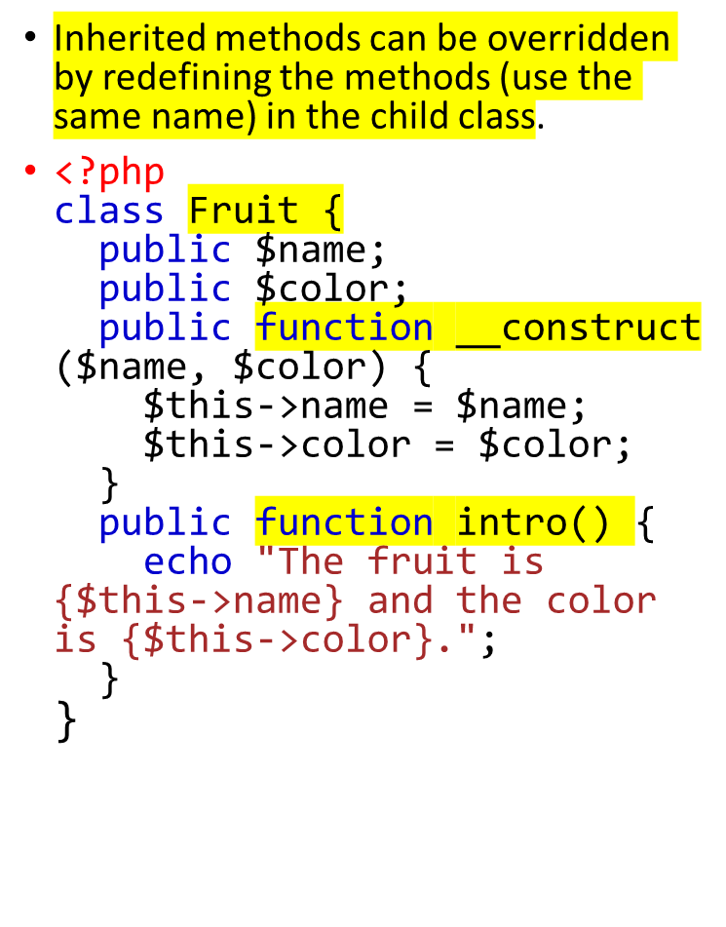
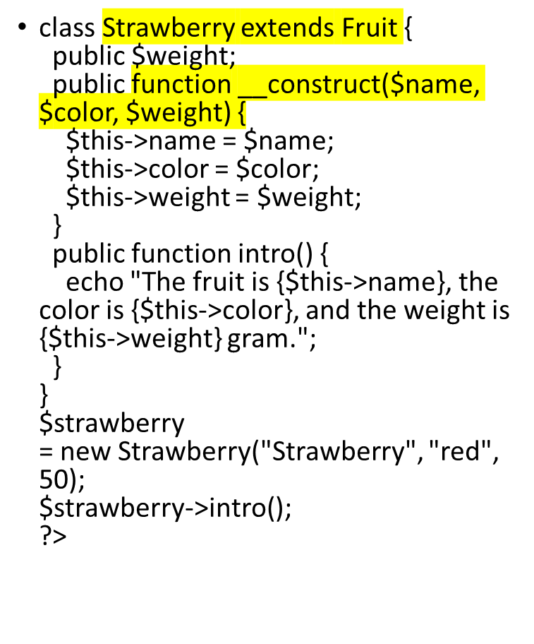
PHP - Overriding Inherited Methods

Slide 22
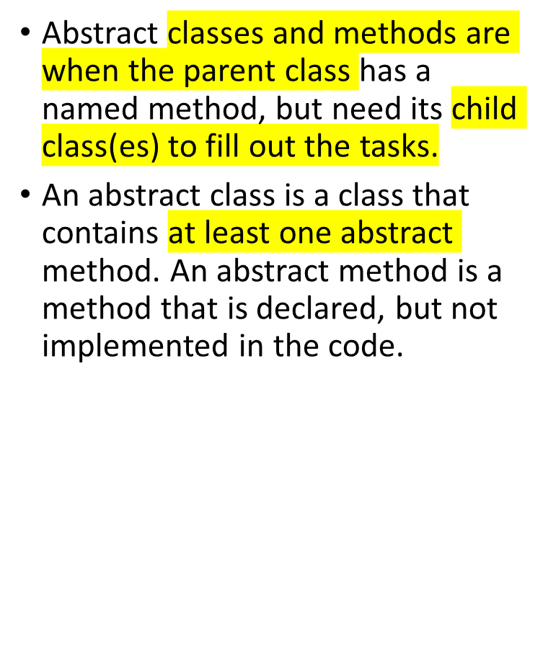
PHP - Abstract Classes and Methods
<?php
abstract class ParentClass {
abstract public function someMethod1();
abstract public function someMethod2($name, $color);
abstract public function someMethod3() : string;
}
?>

Slide 23
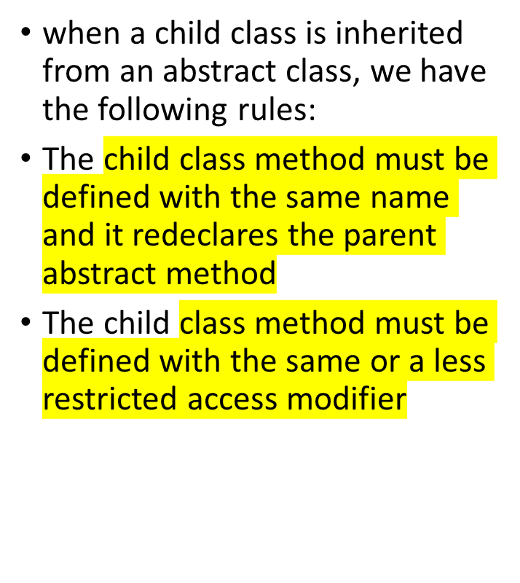
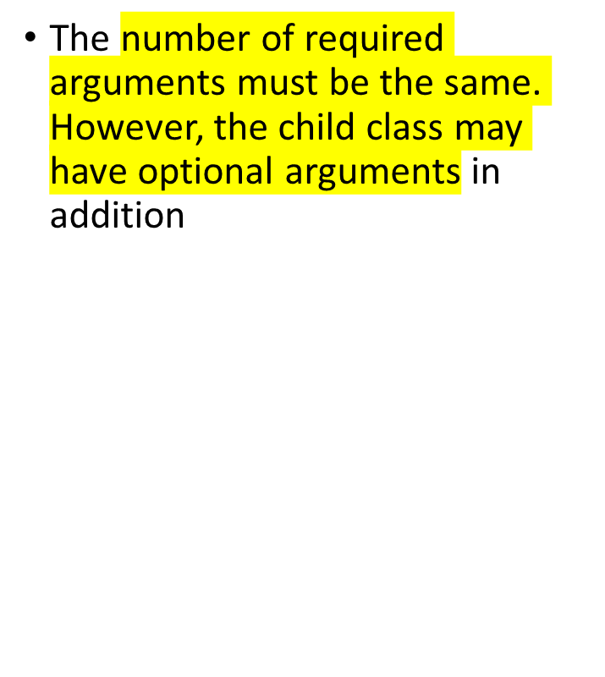

Slide 24
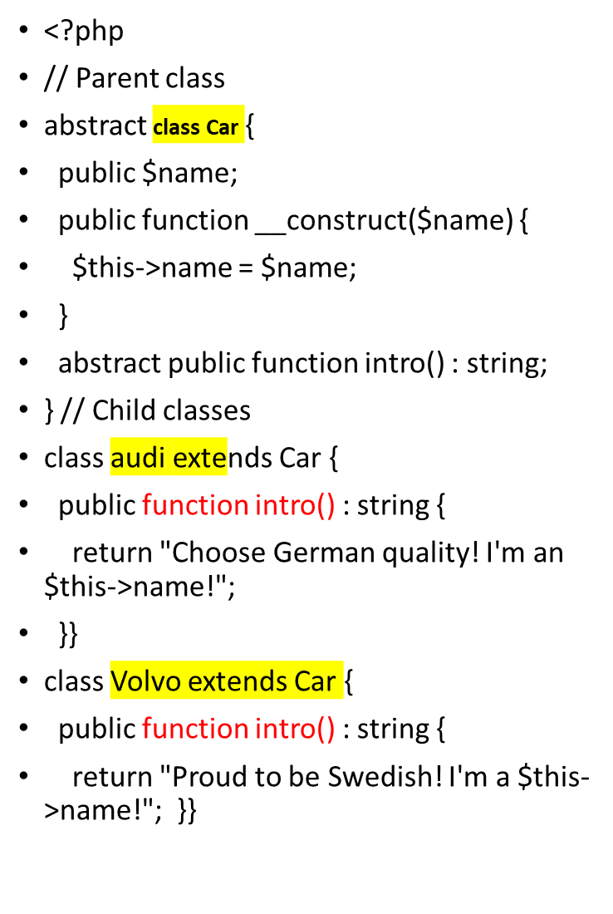
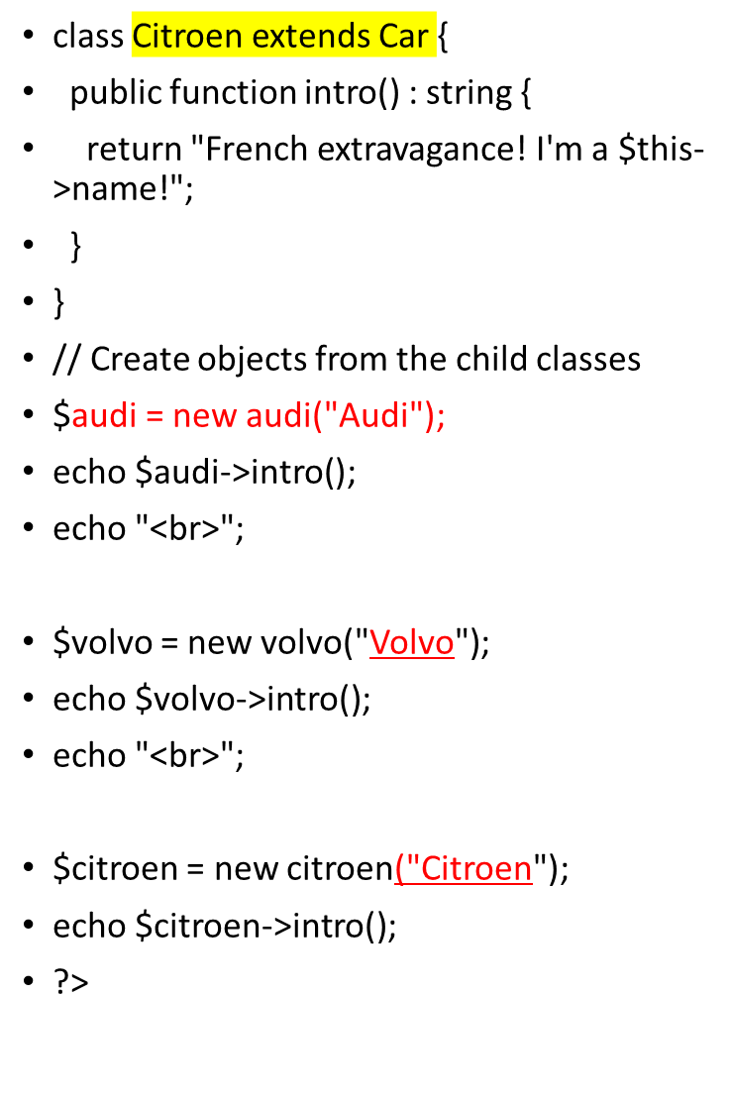

Slide 25
PHP - What are Interfaces?
Interfaces allow you to specify what methods a class should implement.
Interfaces make it easy to use a variety of different classes in the same way. When one or more classes use the same interface, it is referred to as "polymorphism".
Interfaces are declared with the interface keyword:
Syntax
<?php
interface InterfaceName {
public function someMethod1();
public function someMethod2($name, $color);
public function someMethod3() : string;
}
?>

Slide 26


Slide 27
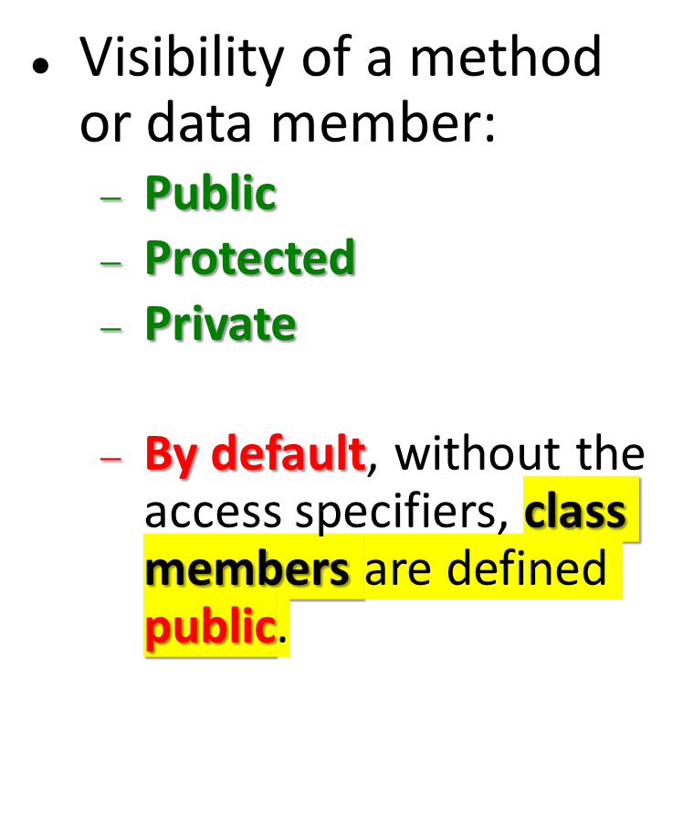
Classes
class MyClassName{
....methods
....data members
}

Slide 28
Private Access Specifier
class MyClassName{
private $strFirstName;
}
private – limits the visibility of the methods and data members only to the class that defines them.

Slide 29
Modifying data members
intNumber is private
Outside the class, trying to execute the following:
$clMyObj->intNumber++;
will fail!...
We need a method to access and change its value:
function setNumber($intNumber) {
$this->intNumber = $intNumber;
}
Look at the position of the dollar sign ($) – no longer attached to the variable name

Slide 30
Public Access Specifier
class MyClassName{
public $strFirstName;
public function getFirstName(){
}
}
public – class members can be accessed both within and outside the class.

Slide 31
Protected Access Specifier
//protected for public use, but accessible in a derived class
Class MyClassName{
protected $strFirstName;
protected function getFirstName(){
}
}
Inherited protected class members – accessible inside a derived class
Visibility of protected class members outside the class definition – protected class members are inaccessible.

Slide 32


Slide 33

PROPERTY DECLARATION

Slide 34
Example: Access Specifiers
<?php
class MyClass {
public $public = 'Public';
protected $protected = 'Protected'; //protected for public use, but accessible in a derived class
private $private = 'Private';
function printHello() {
echo $this->public;
echo $this->protected;
echo $this->private;
}
}
// outside the class definition
$obj = new MyClass();
echo $obj->public; // Works
echo $obj->protected; // Fatal Error
echo $obj->private; // Fatal Error
$obj->printHello(); // Shows Public, Protected and Private
//...
✓
✗
✗
✓

Slide 35
Example: Access Specifiers
a Derived class
<?php
//...
class MyClass2 extends MyClass
{
// We can redeclare the public and protected method, but not private
// protected – ‘protected’ for public use, but accessible in a derived class
protected $protected = 'Protected2';
function printHello()
{
echo $this->public;
echo $this->protected;
echo $this->private;
}
}
// outside the class definition
$obj2 = new MyClass2();
echo $obj2->public; // Works
echo $obj2->private; // Undefined
echo $obj2->protected; // Fatal Error
$obj2->printHello(); // Shows Public, Protected2, Undefined
?>
✓
✗
✗
✓
http://php.net/manual/en/language.oop5.visibility.php

Slide 36
METHOD DECLARATION

Slide 37
Properties and methods can have access modifiers which control where they can be accessed.
There are three access modifiers:
public - the property or method can be accessed from everywhere. This is default
protected - the property or method can be accessed within the class and by classes derived from that class
private - the property or method can ONLY be accessed within the class

Slide 38
<?php
class Fruit {
public $name;
public $color;
public $weight;
function set_name($n) { // a public function (default)
$this->name = $n;
}
protected function set_color($n) { // a protected function
$this->color = $n;
}
private function set_weight($n) { // a private function
$this->weight = $n;
}
}
$mango = new Fruit();
$mango->set_name('Mango'); // OK
$mango->set_color('Yellow'); // ERROR
$mango->set_weight('300'); // ERROR
?>

Slide 39
Example: Method Declaration
<?php
class MyClass
{
// Declare a public constructor
public function __construct() { }
// Declare a public method
public function MyPublic() { }
// Declare a protected method
protected function MyProtected() { }
// Declare a private method
private function MyPrivate() { }
// This is public
function Foo()
{
$this->MyPublic();
$this->MyProtected();
$this->MyPrivate();
}
}
//OUTSIDE THE CLASS DEFINITION...
$myclass = new MyClass;
$myclass->MyPublic(); // Works
$myclass->MyProtected(); // Fatal Error
$myclass->MyPrivate(); // Fatal Error
$myclass->Foo(); // Public, Protected and Private work
//...
✓
✗
✗
✓
http://php.net/manual/en/language.oop5.visibility.php

Slide 40
Example: Method Declaration
<?php
class MyClass
{
// Declare a public constructor
public function __construct() { }
// Declare a public method
public function MyPublic() { }
// Declare a protected method
protected function MyProtected() { }
// Declare a private method
private function MyPrivate() { }
// This is public
function Foo()
{
$this->MyPublic();
$this->MyProtected();
$this->MyPrivate();
}
}
class MyClass2 extends MyClass
{
// This is public
function Foo2()
{
$this->MyPublic();
$this->MyProtected();
$this->MyPrivate(); // Fatal Error
}
}
$myclass2 = new MyClass2;
$myclass2->MyPublic(); // Works
$myclass2->Foo2(); // Public and Protected work, not Private
✓
✓
✗
http://php.net/manual/en/language.oop5.visibility.php

Slide 41
Example: Method Declaration
<?php
class Bar
{
public function test() {
$this->testPrivate();
$this->testPublic();
}
public function testPublic() {
echo "Bar::testPublic\n";
}
private function testPrivate() {
echo "Bar::testPrivate\n";
}
}
class Foo extends Bar
{
public function testPublic() {
echo "Foo::testPublic\n";
}
private function testPrivate() {
echo "Foo::testPrivate\n";
}
}
$myFoo = new foo();
$myFoo->test(); // Bar::testPrivate
// Foo::testPublic
?>
✗
✓
http://php.net/manual/en/language.oop5.visibility.php

Slide 42
Accessing Private Members of the same object type
<?php
class Test
{
private $foo;
public function __construct($foo)
{
$this->foo = $foo;
}
private function bar()
{
echo 'Accessed the private method.';
}
public function baz(Test $other)
{
// We can change the private property:
$other->foo = 'hello';
var_dump($other->foo);
// We can also call the private method:
$other->bar();
}
}
$test = new Test('test');
$test->baz(new Test('other'));
?>
Objects of the same type will have access to each others
Private and protected members even though they are
not the same instances.
string(5) "hello"
Accessed the private method
✓
http://php.net/manual/en/language.oop5.visibility.php

Slide 43


Slide 44
Creating objects
Instantiate classes using new keyword
  $myCart= new ShoppingCart(“Charlie”);
Constructors
  In earlier versions of PHP (< PHP5.3.3) Same as the name of the class. This no longer holds!
  (PHP5 only) declared as
  public function __construct(…)
Destructors
  Declared as
    public function __destruct()

Slide 45
Latest in PHP5.3.3
<?php
namespace Foo;
class Bar {
public function Bar() {
// treated as constructor in PHP 5.3.0-5.3.2
// treated as regular method in PHP 5.3.3
}
}
?>

Slide 46
Constructors
A constructor is a function that does initializations when the class is instantiated
function __construct($intNumber, $strName){
$this->set_intNumber($intNumber);
$this->set_strName($strName);
$this->printInit();//use this method
}

Slide 47
Constructors
Default arguments
function __construct ($strName = “A”, $intNumber=0) {
$this->set_intNumber($int_Number);
$this->set_strName($str_Name);
}
Instantiating a class without parameters will make use of the default values

Slide 48
Another Example: Constructors
<?php
class vehicle {
private $strDescription;
function getDescription() {
return $this->strDescription;
}
function setDescription($strDescription) {
$this->strDescription = $strDescription;
}
function __construct ($strDescription) {
$this->strDescription = $strDescription;
}
}
?>
vehicle.php

Slide 49
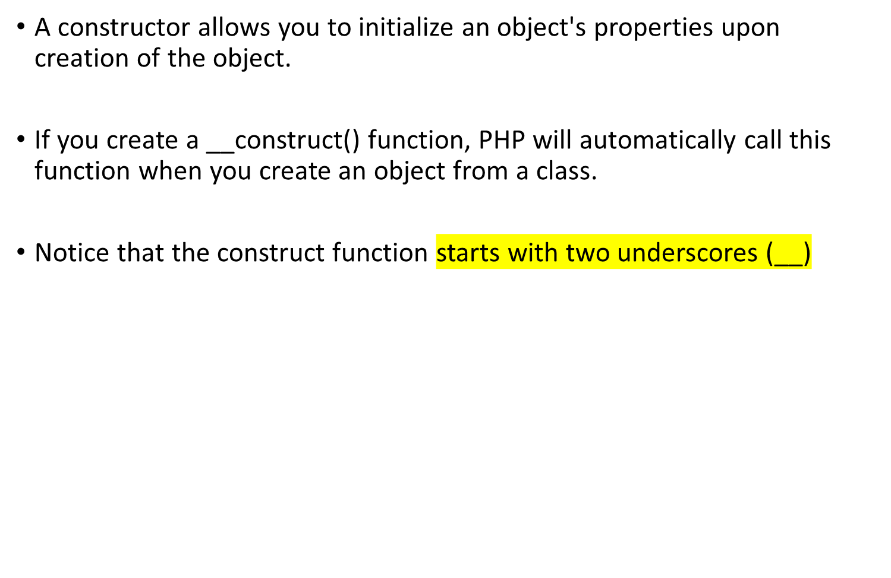

Slide 50
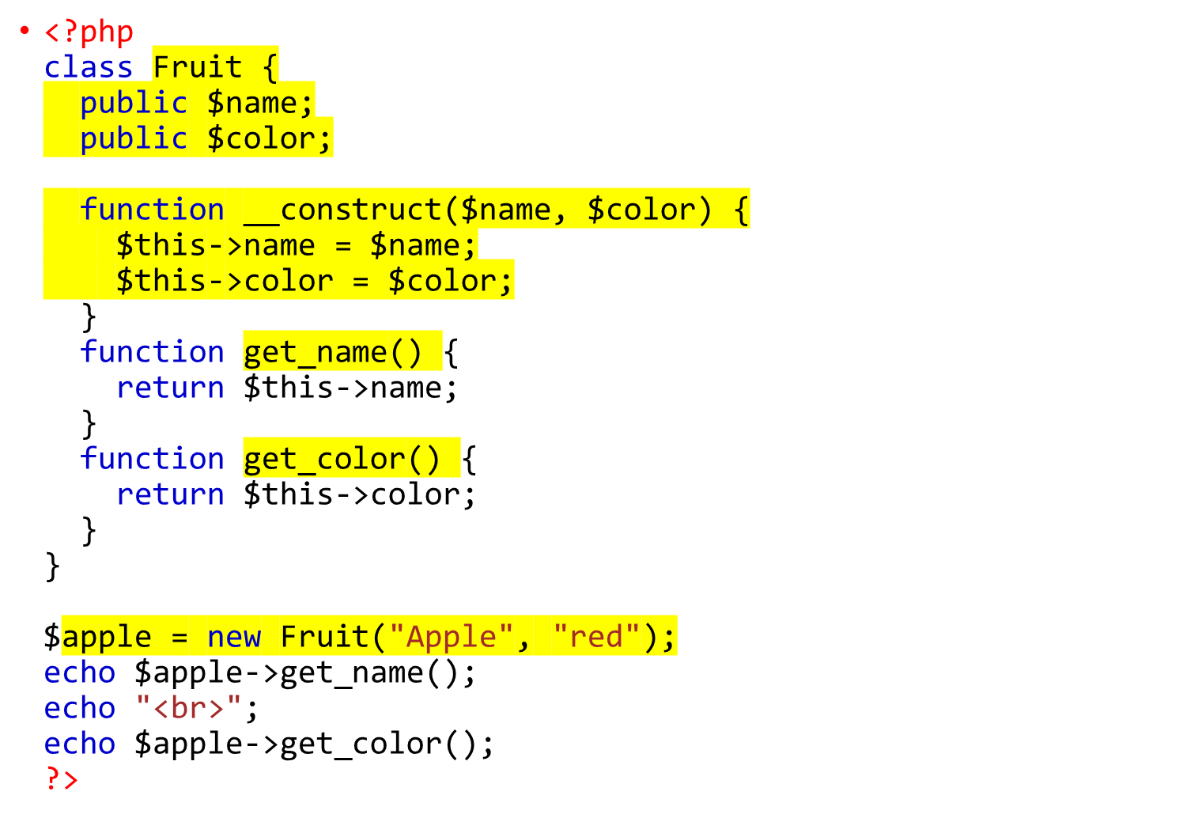

Slide 51
Another Example: Constructors
<?php
require_once("vehicle.php");
$objBike = new vehicle("Bicycle");
echo "<p>Vehicle: " . $objBike->getDescription() . "</p>";
?>
example16-7.php

Slide 52
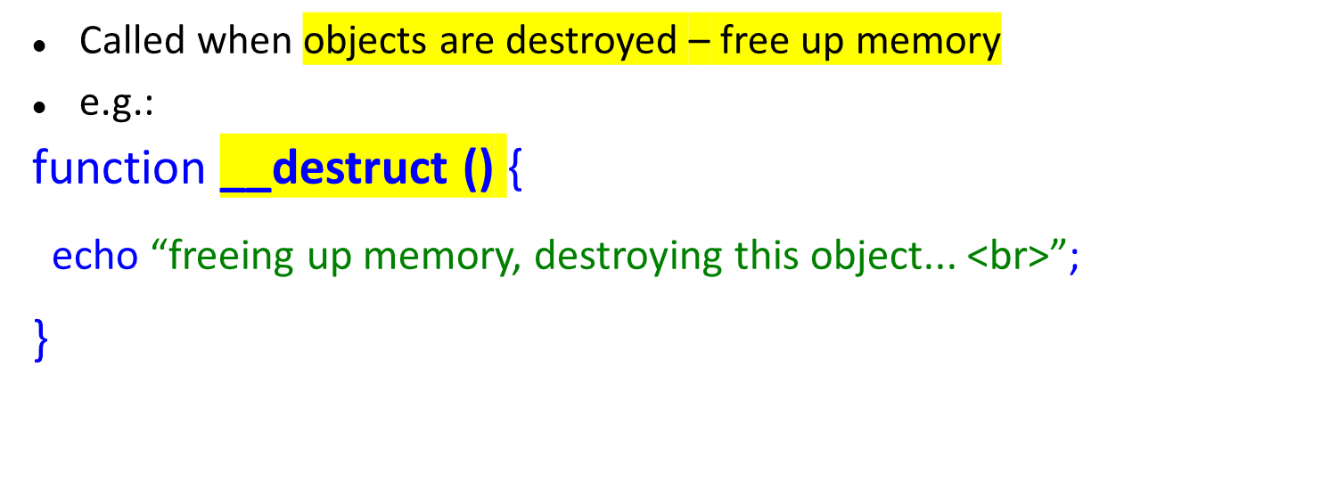
Destructors
This sample code above simply informs us that the object is being destroyed already.

Slide 53
PHP - The __destruct Function
A destructor is called when the object is destructed or the script is stopped or exited.
If you create a __destruct() function, PHP will automatically call this function at the end of the script.
Notice that the destruct function starts with two underscores (__)!

Slide 54
<html>
<body>
<?php
class Fruit {
// Properties
var $name;
var $color;
// Methods
function __construct($name, $color) {
$this->name = $name;
$this->color = $color;
}
function __destruct() {
echo "The fruit is {$this->name} and the color is {$this->color}.";
}
}$apple = new Fruit("Apple", "red");?></body></html>

Slide 55
Objects as variables
Can be used in arrays
Can be passed to functions
Passed as reference all the time (PHP 5)
e.g.:
function test1($objClass1){
$objClass1->set_intName(“B”);
}
No need to use & in the formal parameter definition. It is always passed by reference.

Slide 56
Arrays and objects
<?php
function __autoload($class_name) {
require_once $class_name . '.php';
}
$objSimon = new revisedperson("Simon", "Stobart");
$objLiz = new revisedperson("Liz", "Hall");
$objIan = new revisedperson("Ian", "Walker");
$objBilly = new revisedperson("Billy", "Lee");
$objHayley = new revisedperson("Hayley", "West");
$arrPeople = array($objSimon, $objLiz, $objIan, $objBilly, $objHayley);
foreach($arrPeople as $objThePerson){
echo($objThePerson->display());
}
?>
example16-9.php
The function display() is common to all array elements (elements = objects in this example).

Slide 57
Multiple Object Instances
<?php
$cart1 = new ShoppingCart(“Joe Bloggs”);
$cart1->addItem("10", 1);
$cart2 = new ShoppingCart(“Fred Smith”);
$cart2->addItem("0815", 3);
?>

Slide 58
Example: Polymorphism
<?php
function __autoload($class_name) {
require_once $class_name . '.php';
}
$objRectangle = new rectangle(100,50, "rectangle.gif");
$objSquare = new square(100, "square.gif");
$objTriangle = new triangle(50,100, "triangle.gif");
$objEllipse = new ellipse(50,100, "ellipse.gif");
$arrShapes = array ($objRectangle,$objSquare,$objTriangle,$objEllipse);
foreach ($arrShapes as $objShape){
$objShape->display();
$objShape->area();
}
?>
Example17-5.php
The functions area() and display() are common to all array elements, but executes a different formula for each type of object.

Slide 59

Recommended: Create one PHP source file per class definition.
This aids class reuse and script clarity.

Slide 60
Remember these PHP Constructs?
require(….)
  Includes file specified, terminates on errors
include(…)
  Includes file specified, gives warning on errors
require_once(….)
  Includes file specified only if it has not already been included, terminates on errors
include_once(….)
  Includes file specified only if it has not already been included, gives warning on errors
✓
Really useful but would require you to write a long list of include() or require() statements
at the beginning of each script, one for each class.
Example16-6.php

Slide 61
function __autoload()
The function is invoked automatically each time a class is required but has not been defined.
We can insert this function into our script:
function __autoload($class_name) {
require_once $class_name . '.php';
}
Note: Class_name = File_name
Example16-7.php

Slide 62
function __autoload()
<?php
function __autoload($class_name) {
require_once $class_name . '.php';
}
$objSimon = new person;
$objSimon->setDisplayFirstnameSurname(“Napoleon", “Reyes");
$objBike = new vehicle("Bicycle");
echo "<p>Vehicle: " . $objBike->getDescription() . "</p>";
?>
Class definition comes from another file.
Example16-7.php

Slide 63
Exceptions
Like all good OO languages, PHP5 supports the exception mechanism for trapping and handling “unexpected conditions”
Note: not all exceptions are necessarily errors
Exceptions not supported in PHP4

Slide 64
Exceptions
Extend the built-in PHP Exception class with your own exceptions (as in Java)
class MyException extends Exception {
// Redefine the exception so message isn't optional
public function __construct($message, $code = 0) {
// some code
// make sure everything is assigned properly
parent::__construct($message, $code);
}
// custom string representation of object
public function __toString() {
return __CLASS__ . ": $this->message\n";
}
public function customFunction() {
echo "A Custom function for this type of exception\n";
}
}
To generate an exception
<?php
Throw new MyException("Message to display");
?>

Slide 65
Objects can...
Invoke another
Be embedded within another object
Support for:
  Inheritance
  Scope resolution ( :: operator)
  Class abstraction (define a class that does not instantiate, use “abstract class classname”)
  Polymorphism (same function names with different data / behaviour)
  '==‘ to check if two object have the same attributes and values
  '===‘ to check if two objects are the same instance of the same class

